Slide 1



Bid Your Dream House
--San Francisco Bay Area House Price Prediction
Leilei Liu • June 2018

Slide 2
Contents
Introduction
Dataset
Data Facts
Exploratory Data Analysis
Linear Regression
Conclusion
Attachment

Slide 3
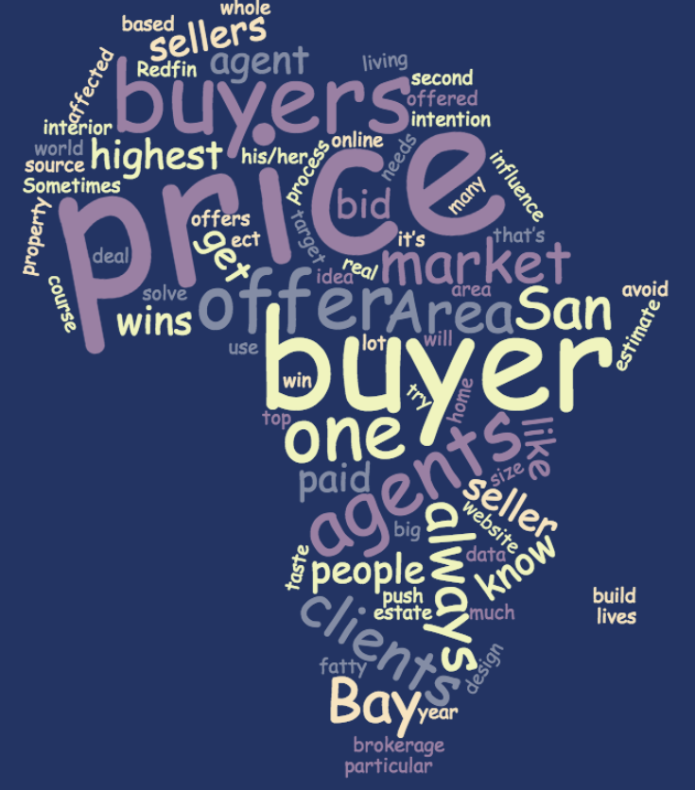
Introduction
Home buyer has limited resources to offer a reasonable bid price

Slide 4
Dataset
Property data is from Redfin.com
City boundary shapefile is from ca.gov

Slide 5
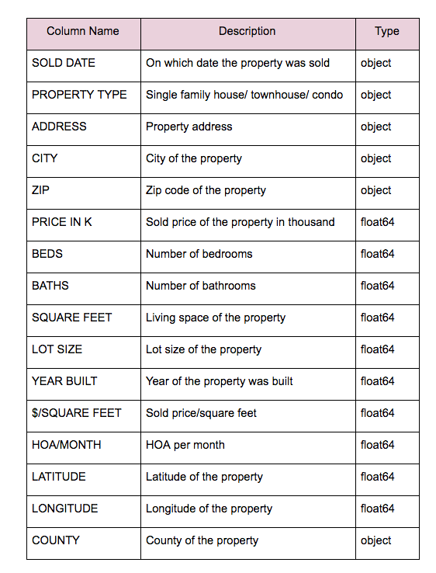
Data Facts
Data volume: After data cleaning, there are 32416 rows and 16 columns in the dataset.
Data Dictionary

Slide 6
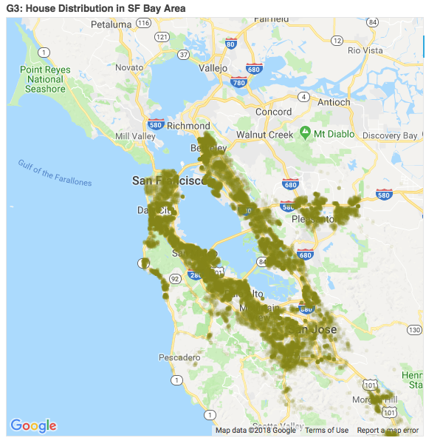
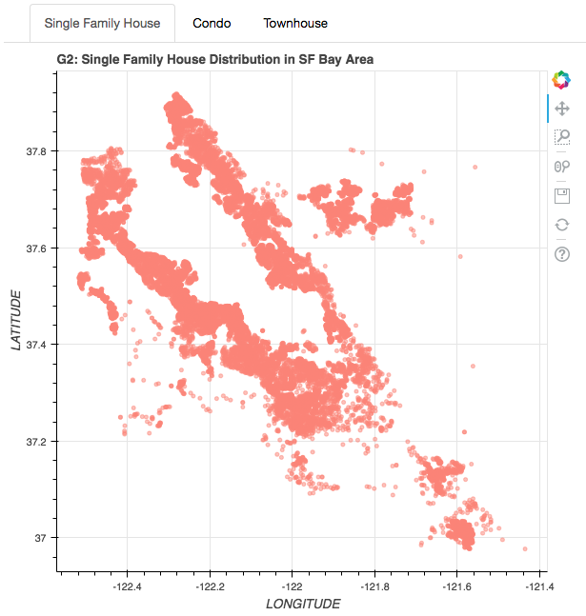
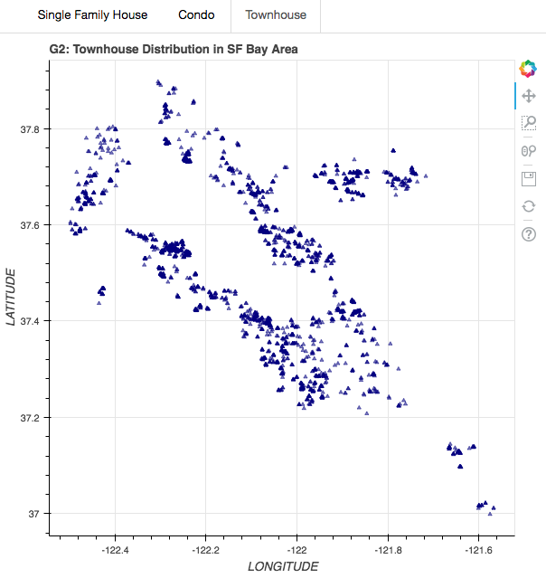
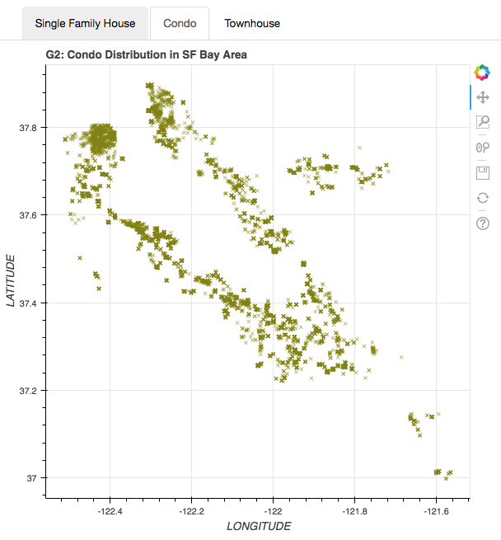
Exploratory Data Analysis
Property distribution

Slide 7
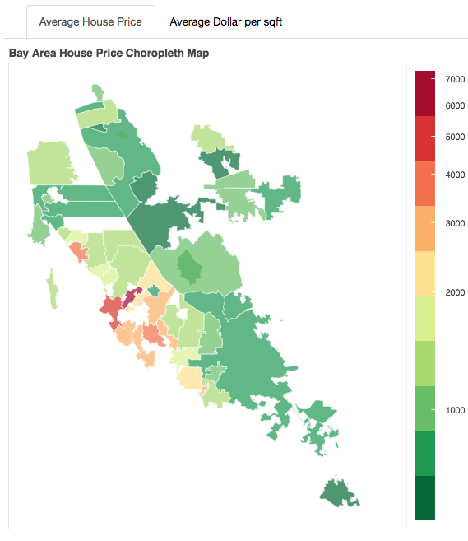
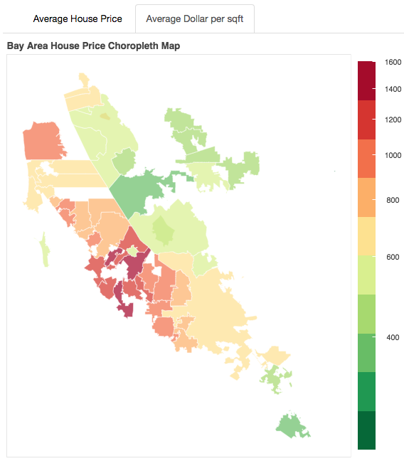
Exploratory Data Analysis
Average total price vs. Average Unit Price ($ per sqft)

Slide 8
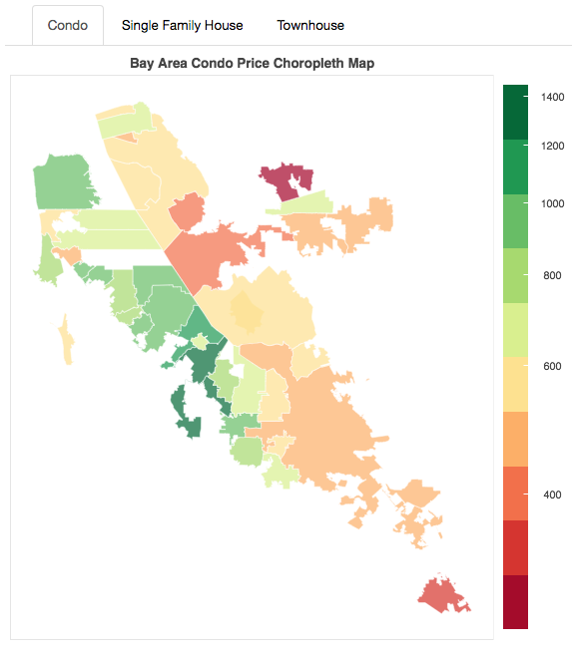
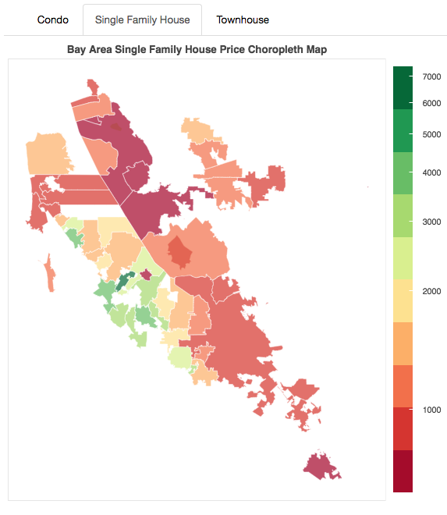
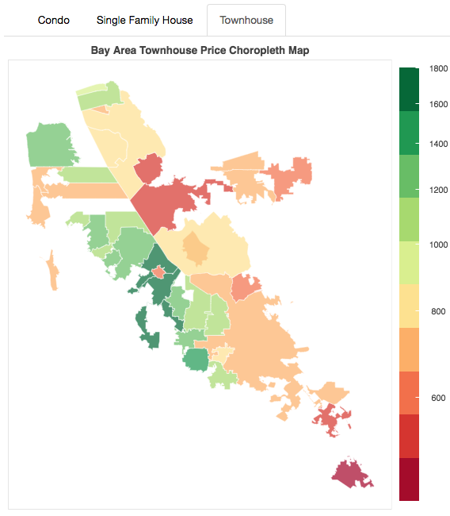
Exploratory Data Analysis
Price Based on Property Type

Slide 9
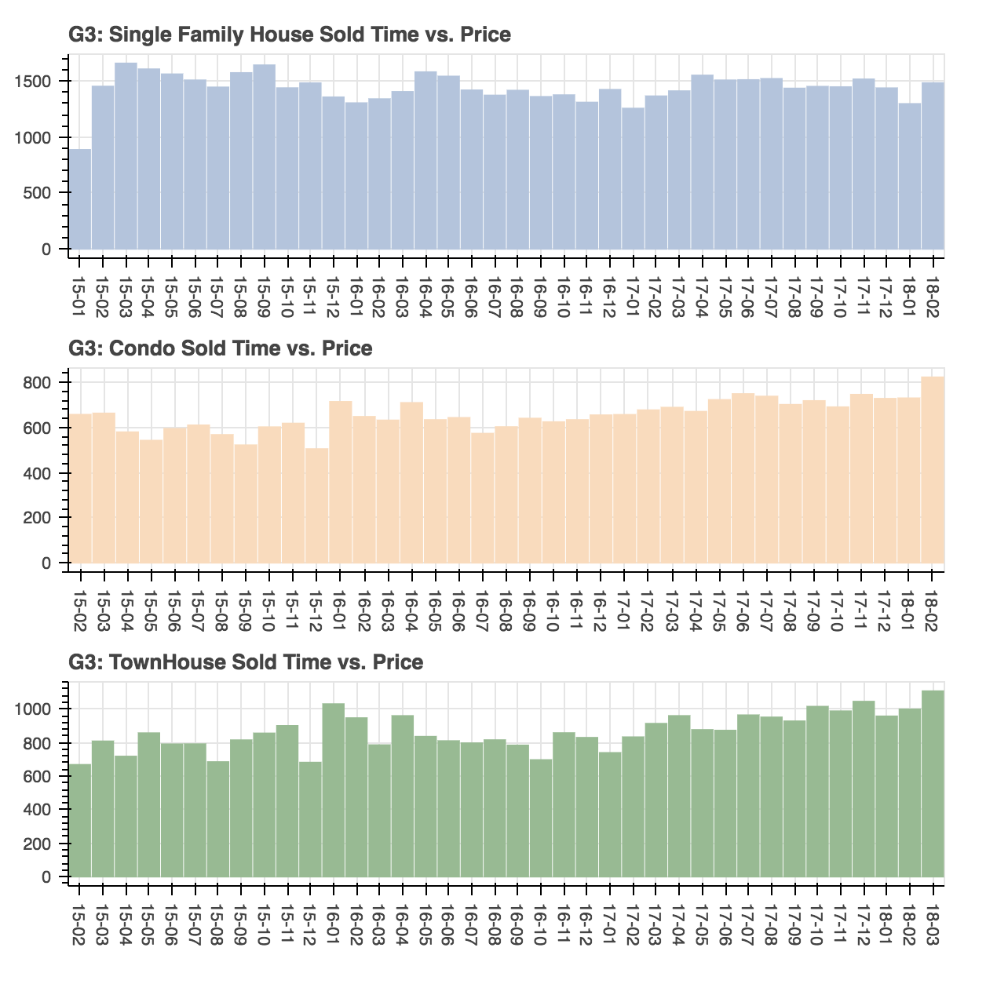
Exploratory Data Analysis
Average Price Trend by Month

Slide 10
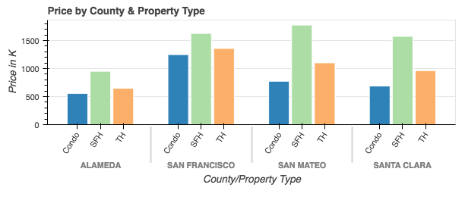
Exploratory Data Analysis
Price by County and Property Type

Slide 11
Machine Learning
Linear Regression
Train three different models for each property type (single family house, townhouse and condo);
Train three different models based on three different types of location (zip, city, county);
General model contain different types of property and all types of location.

Slide 12
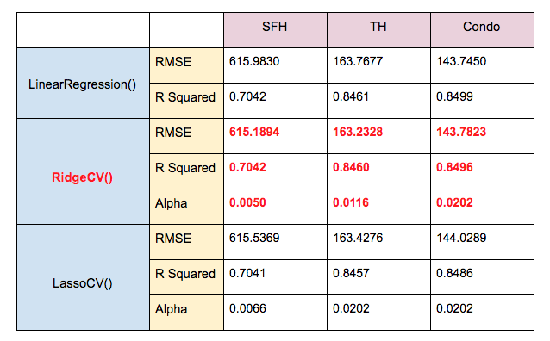
Conclusion
Analysis
Best model is using three Ridge regression model on different property types.

Slide 13
Conclusion
Limitation
Some cities with few sold property in the dataset may have less accurate prediction.
If the dataset contains neighborhood name and remodel year, it would help us improve the accuracy.

